Slide 1
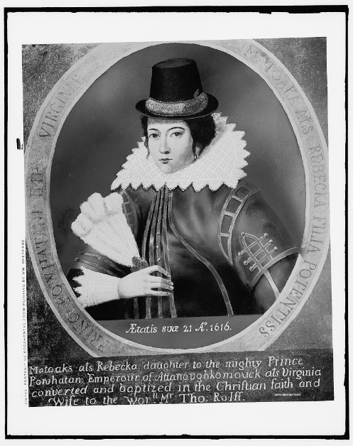
“Virginia Company Song”
https://www.youtube.com/watch?v=Ne2tzfxQ6T4

Slide 2
THE COLONIES: Settlements, Alliances, and Resistance 1607-1718
© 2015 Pearson Education, Inc. All rights reserved.

Slide 3
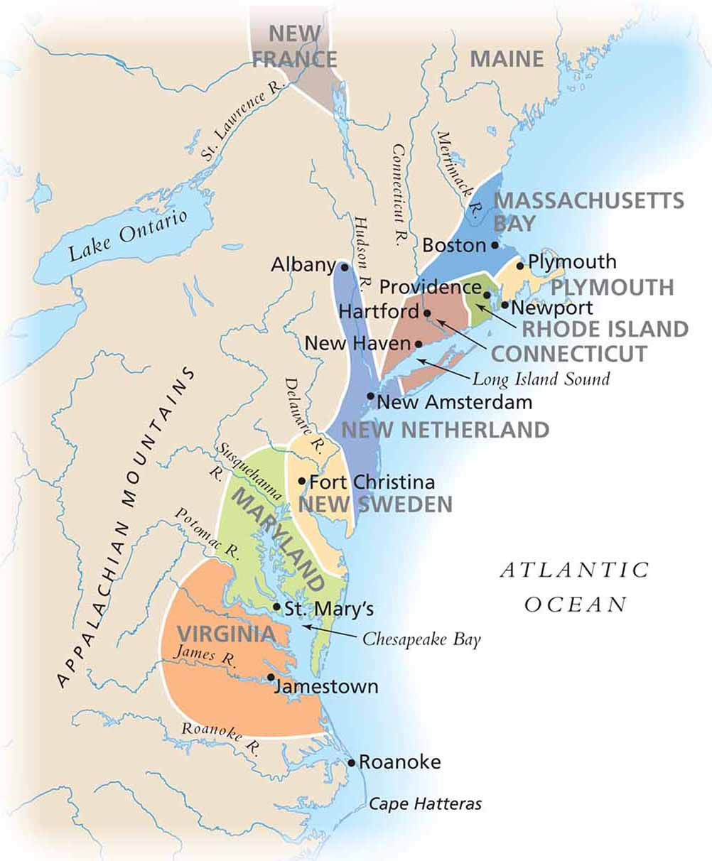
The English Settle in North America
Spread of Settlement: Atlantic Coast European

Slide 4
Regions of the Colonies
New England (Massachusetts, Connecticut, Rhode Island, New Hampshire) – British Colonies
Middle Colonies “Bread basket” - New York, New Jersey, Pennsylvania, Delaware
Chesapeake (Virginia & Maryland) – British Colonies
Southern Colonies – North Carolina, South Carolina, Georgia
BARBADOS** - 14th colony (British Island colony in the Caribbean set the blue print for slavery in the American south)

Slide 5
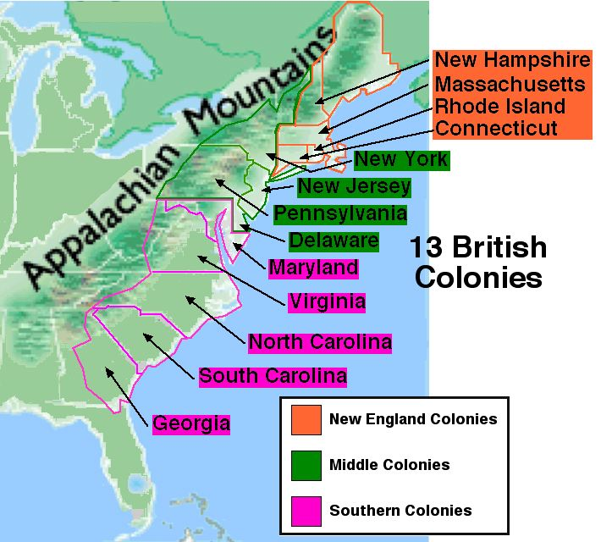

Slide 6
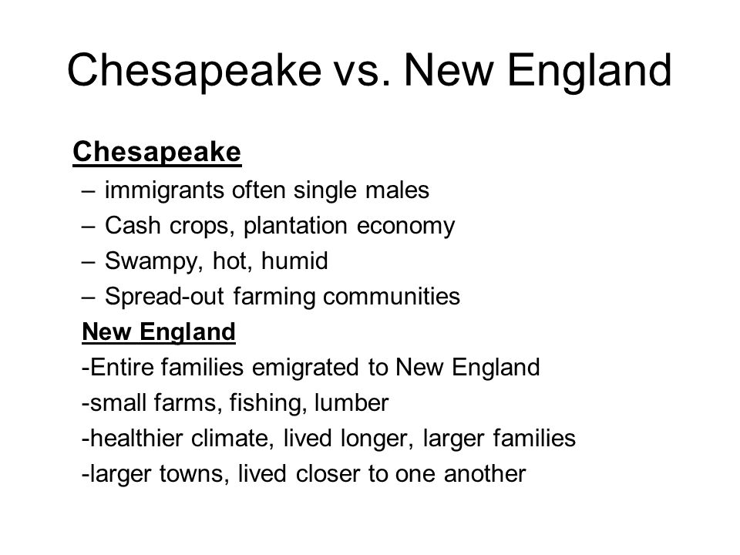

Slide 7
Colonizing Virginia: Jamestown
1607 - Jamestown became the first permanent English settlement in North America
1st permanent English settlement in the new world
Funded by VA. Co. of London for profit
Early years = disaster!
1608 = 38/144 colonists still alive
1610 60/500 settlers who had come over still alive
One ruler, Powhatan, controlled virtually all of the Indians nearby.
Jamestown built on a swamp - mosquitoes and malaria

Slide 8
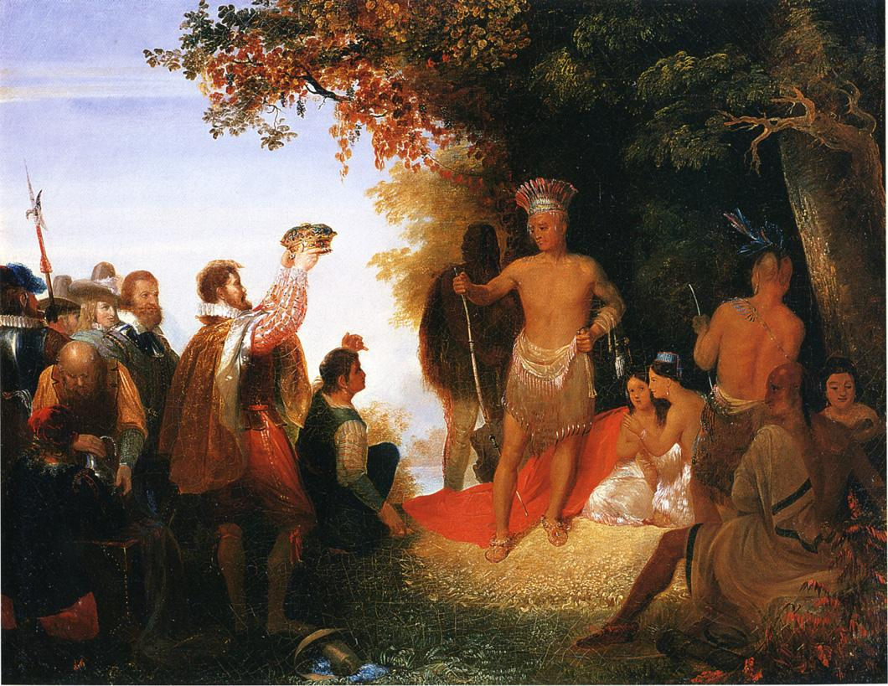
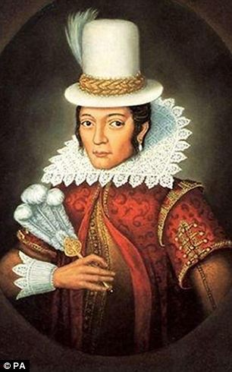
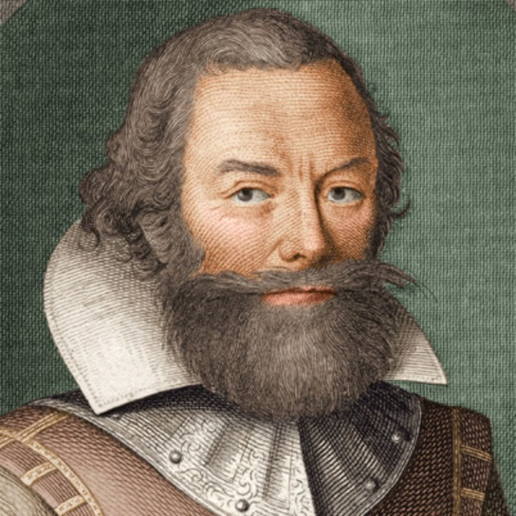
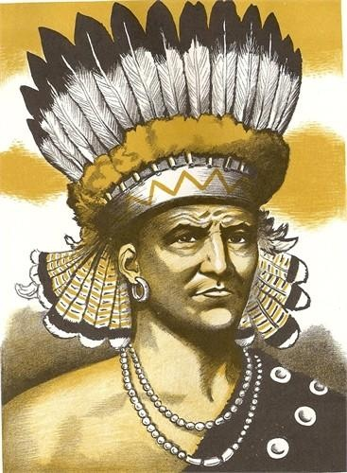
Pocahontas… NOT the Disney Version
Capt. John Smith rallied the settlers at Jamestown
“he who shall not work, shall not eat”
Trading, Farming, Manufacturing NOT GOLD
Served as leader from 1608-1609
Led colonists to explore the region
Captured by Powhatan and threatened with execution
Smith saved by Powhatan’s daughter Pocahontas
Smith returned to England in 1609

Slide 9
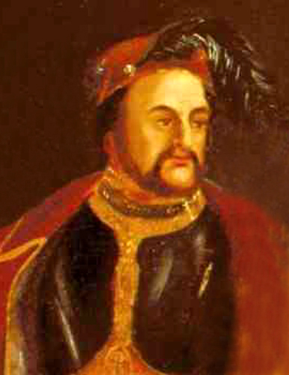
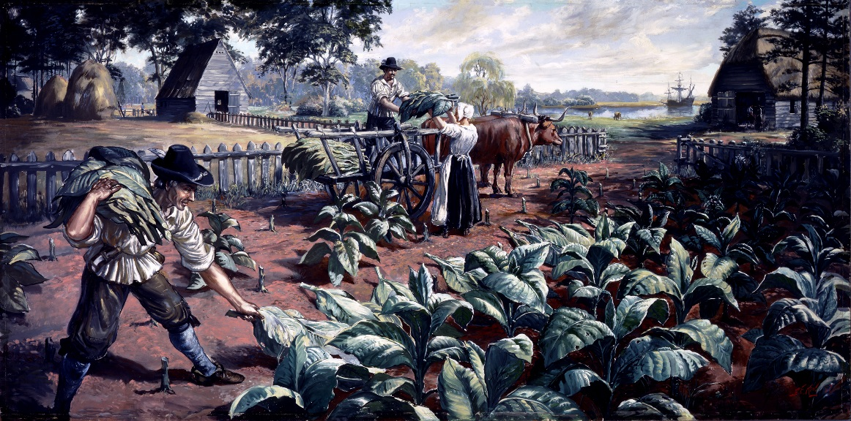
Starving time → Cash Crops
Winter of 1609-1610 “starving time” - over 80% of 500 settlers died
all but 60 of 214 colonists died (they had never planned to grow their own food)
1613 – tobacco imported to Jamestown
John Rolfe credited with cultivating a pleasant smoking strain 1st profitable export
Tobacco would become the feature cash crop of Virginia “Golden Weed”
1620 – 40,000 lbs
1626 – 500,000 lbs
1629 – 1.5 million pounds

Slide 10
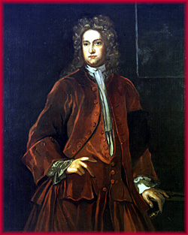
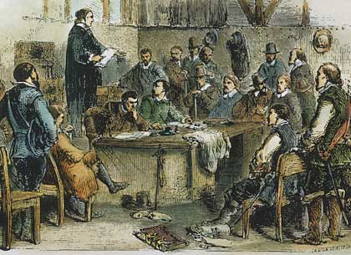
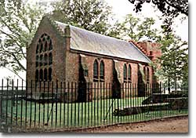
House of Burgesses, 1619
1st representative assembly in British North American colonies
At first all free adult men could participate
Then only large planters can vote
Set precedent for other representative assemblies in British N. America
William Berkeley: Served twice as governor of VA
Established friendly relations with VA Indians to promote trade

Slide 11
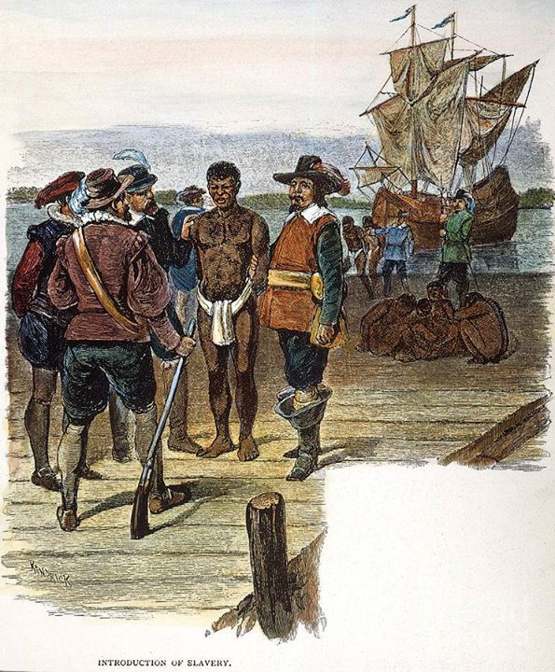
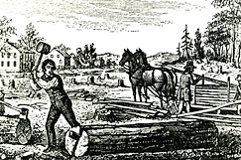
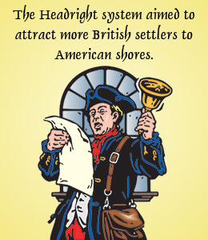
Colony → Home
Headright System: 50 acres per indentured servant
Women: a shipload of unmarried women brought and encouraged to marry colonists and begin families (1619)
Governance: Colonies were to elect 2 “burgesses” or representatives to assemble at Jamestown annually to help make laws for the colony
Indentured Servitude: 4-7 yr contract in exchange for passage
Slavery: African slavery didn’t take root till 1600
Before that primarily Indentured Servitude
Slavery considered backward
By 1300 slavery didn’t exist in N & W Europe

Slide 12
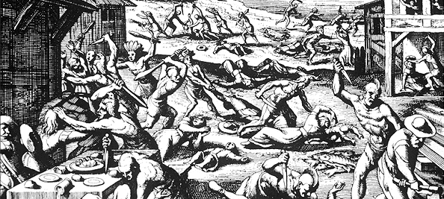
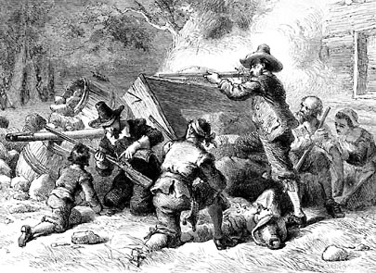
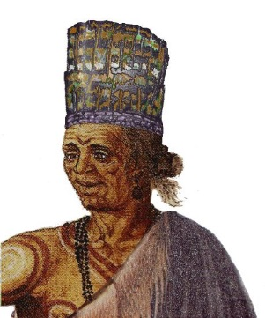
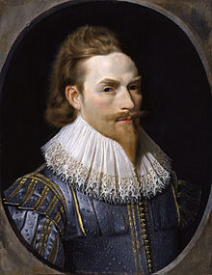
Rebellion
Powhatan Wars: Algonquian Indians
Series of 3 wars 1610-14, 1622-26, 1644-46
Relative peace existed between settlers and Powhatan Indians until Powhatan died in 1622
3rd and Final war essentially ended any real Powhatan Indian threat in VA
Bacon’s Rebellion: Virginia, 1676
Tensions arose between settlers and Indians living on the frontier of western Virginia
Bacon organized his own militia of hundreds of runaway servants and some slaves
Summer of 1676 - Bacon marches on Jamestown and burns the city

Slide 13
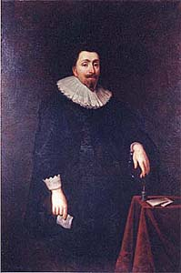
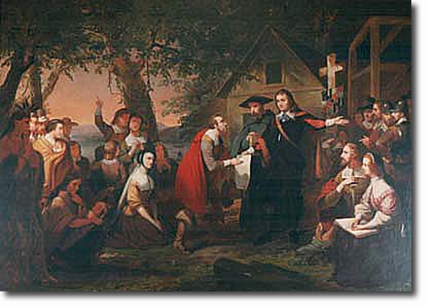
Maryland
The colony was the vision of Sir George Calvert (Lord Baltimore)
Sought a refuge for Catholics in America
1632 - granted a charter for Maryland
He died before colony establashed, but his son Cecilius took over
Similar Economy to VA
Maryland Act of Tolerantion, 1649
Religious Toleration for all

Slide 14
NATIVES & ENGLISH
https://www.youtube.com/watch?v=TTYOQ05oDOI&index=3&list=PL8dPuuaLjXtMwmepBjTSG593eG7ObzO7s

Slide 15
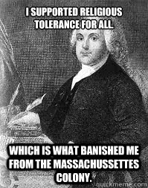
NEW ENGLAND
Massachusetts, Connecticut, Rhode Island, New Hampshire
(All British colonies)

Slide 16
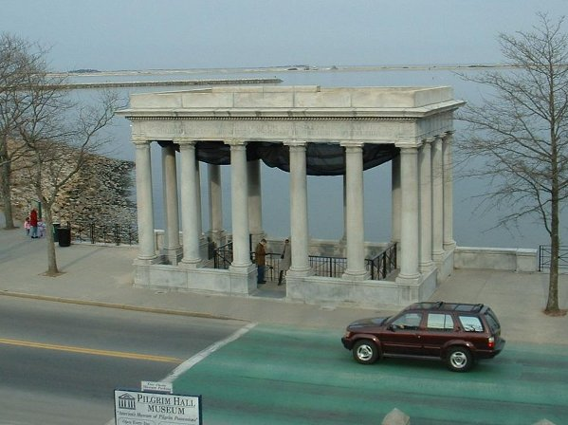
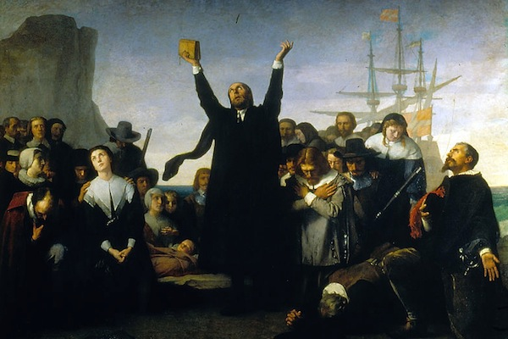
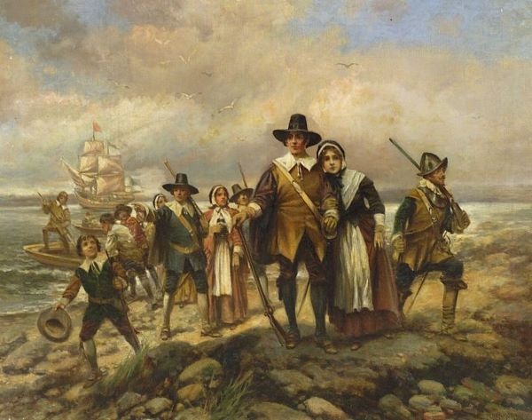
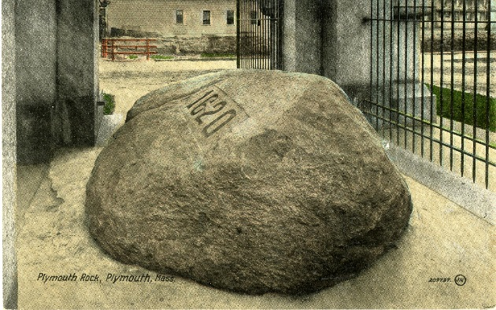
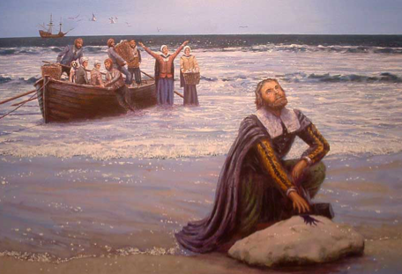
Pilgrims!
Founded Plymouth 1620
William Bradford: Governor of Plymouth (1621-1657)
original Pilgrim settler
signed Mayflower Compact
First Social Contract for a New England colony. Drafted and signed by 41 adult male Separatists fleeing religious persecution by King James of England. Granted political rights to all male colonists who would abide by the colony’s laws.
**Pilgrims: Separatist Puritans who wanted to break from the Church of England. A minority group from the Puritans.

Slide 17
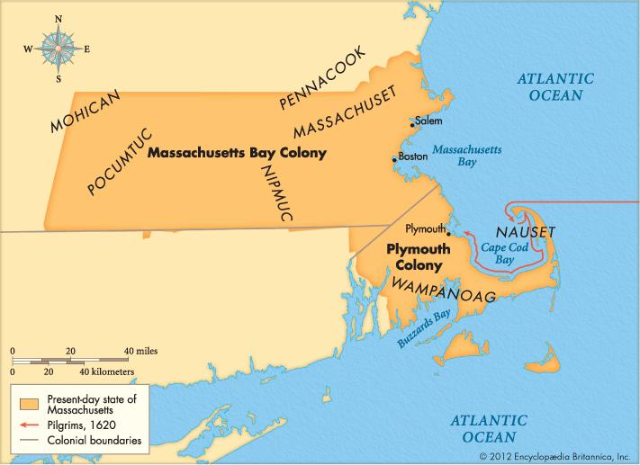
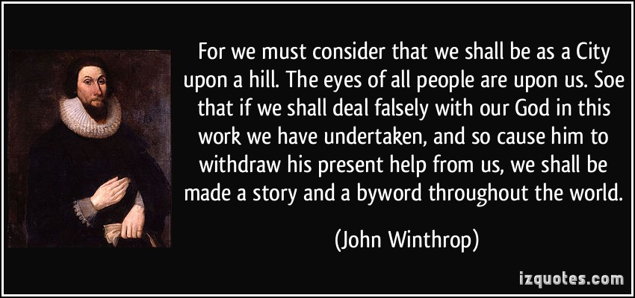
Puritans & Massachusetts Bay (1629)
Puritans - wanted to “purify” the Church of England
They were MAINSTREAM
John Calvin: individual salvation was subject to a divine plan rather than actions of individuals. Everyone has a “calling” or work on earth that God intends for them to do.
First colonists arrived in 1630, building in what they called Salem.
John Winthrop – Puritan leader (Governor for 12 years!)
“CITY UPON A HILL” or “COMMUNITY OF SAINTS”
IE: they wanted to be a model for Christianity
Protestant Ethic!

Slide 18
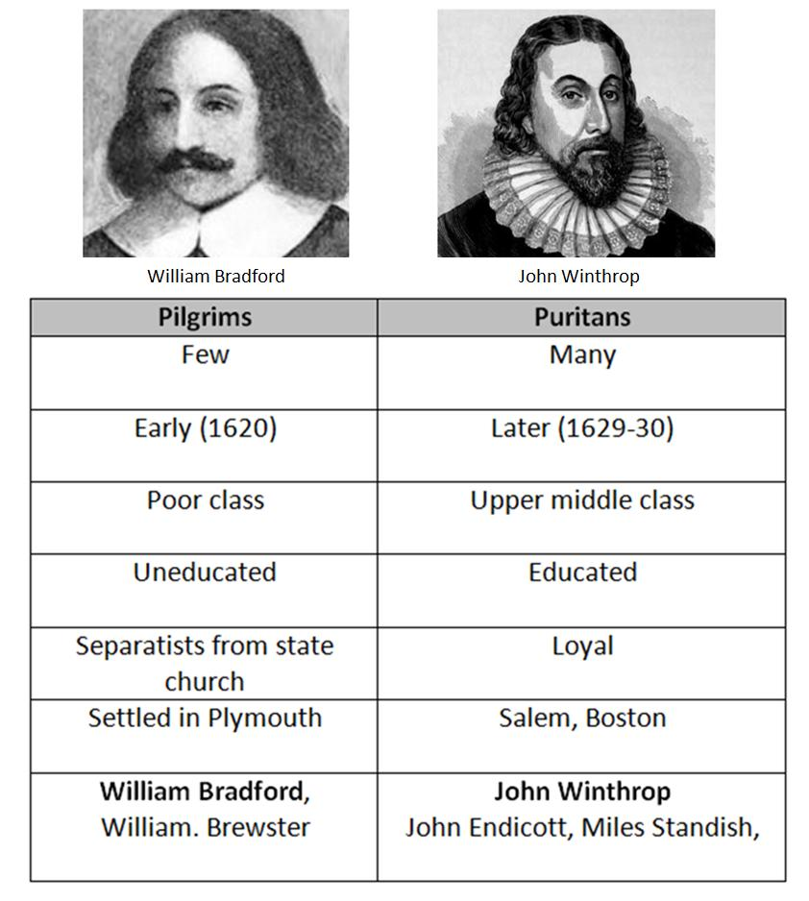
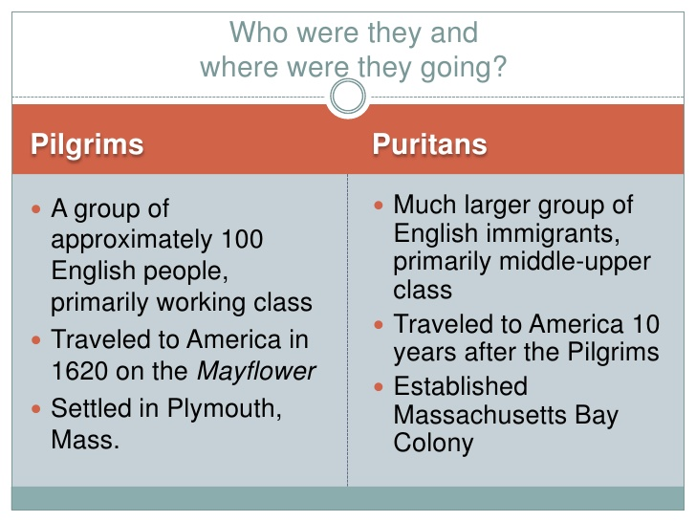

Slide 19
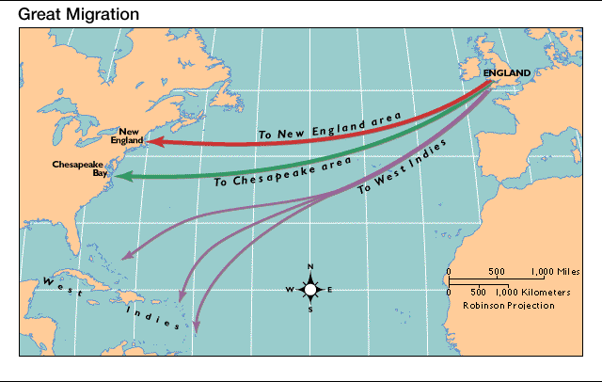
Great Migration: 1630-1640
Beginning with 700 people led by Governor John Winthrop. A great migration of Puritans from England brought over 20,000 people
mostly families
To New England over a 10 year period!

Slide 20
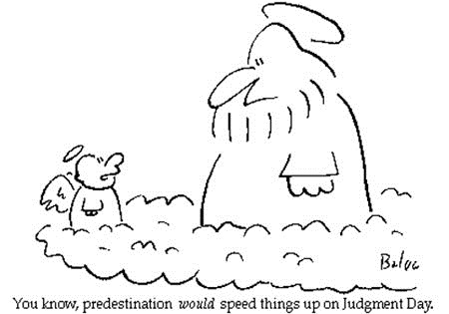
Predestination
A fundamental Puritan belief that God chose each human being from birth for either salvation or condemnation. Only God new the fate of each person but during his or her lifetime, a Puritan could search for clues as to the fate of their soul by performing good works, praying, and attending church services
Although it won’t change you predetermined fate
Adhering to a life of morality and hard work was an indication of God’s grace
But a life of immorality and laziness was an indication of God’s condemnation

Slide 21
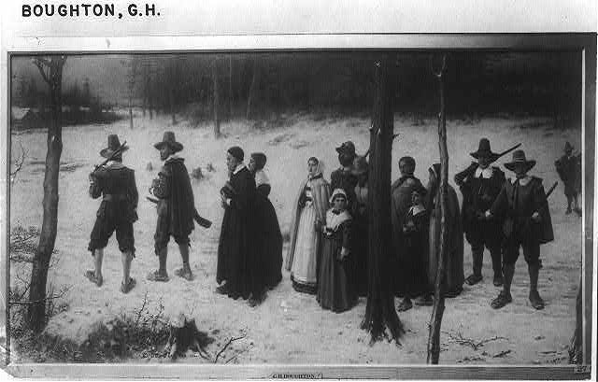
The “Elect” or “Visible Saints”
Those given the gift of God’s grace and those predestined by God for salvation
They became full members of the Puritan Congregational Church
ONLY the “ELECT” could vote and hold public office

Slide 22
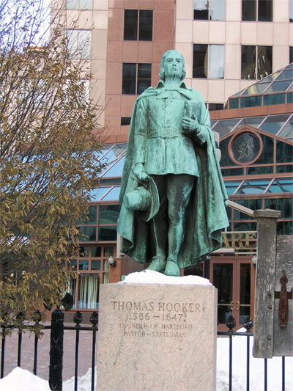
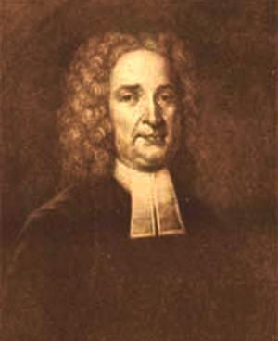
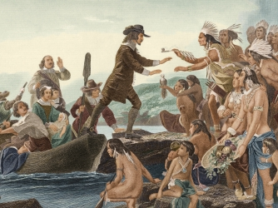
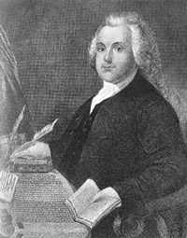
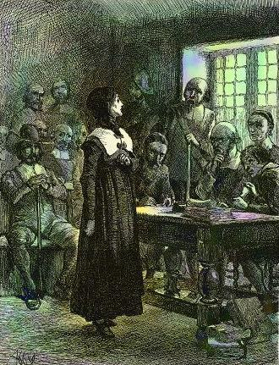
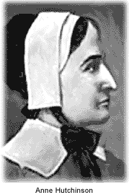
The Outspoken & Disagreeable
Thomas Hooker – banished from Massachusetts Bay in 1635 he founded Connecticut in 1636
Thomas Hooker was a prominent Puritan colonial leader, who founded the Colony of Connecticut after dissenting with Puritan leaders in Massachusetts. He was known as an outstanding speaker and a leader of universal Christian suffrage.
Roger Williams - banished from Massachusetts Bay in 1635 he and his followers founded Rhode Island in 1636.
Religious Liberty & Separation of Church and State
R.I.: became a safe haven for Baptists, Quakers, Jews, and other religious minorities.
Anne Hutchinson - excommunicated by Winthrop in 1637, ended up in Rhode Island
Antinomianism: a belief that Christians are released by grace from the obligation of observing moral law
Spoke out against predetermination
Said that Christians can have a direct relationship with God
No need for ministers or Gov’t officials

Slide 23
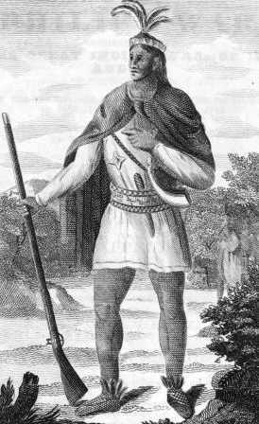
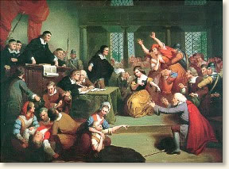
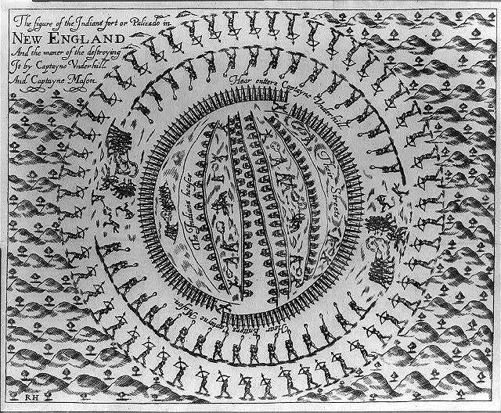
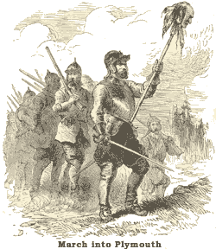
Disorder
Pequot War (1636): Conflict between Pequot Indians and colonists in MA & CT. The Indians were outmatched from the beginning and by the end were sold into slavery or driven off.
Metacom’s War aka King Phillip’s War (1675-76): Last significant effort by the Indians of southern New England to drive away English settlers. VERY VERY VIOLENT!
Metacom was killed and his head put on a steak
Salem Witch Trials (1692): Developed out of religious and political divisions in New England. Non-conformist women became scapegoats and 150 women were imprisoned, 20 executed (19 hung publicly)

Slide 24
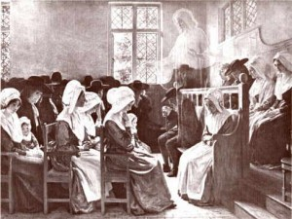
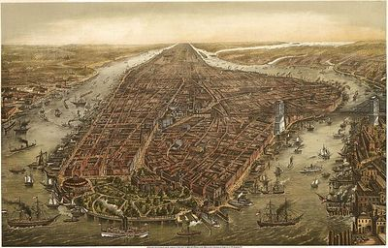
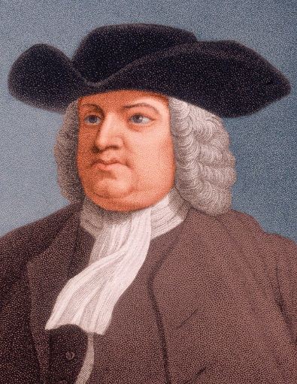
Additional Colonies: Continued Settlement and Development
Carolinas - most settlers were former indentured servants from Virginia and Maryland or Barbados
New York - was originally New Netherland, founded by the Dutch
Pennsylvania - the colony was largely the work of one man - William Penn, was granted colonial charter from Charles II
Quakers: “Society of Friends” guaranteed liberty of conscience and grated freemen the right to alter their government

Slide 25
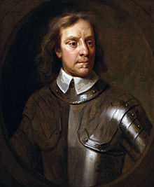
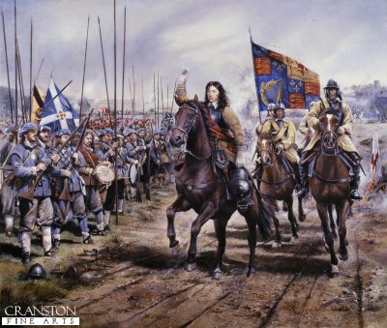
Civil War and Revolution in England
By 1642, England was in a civil war
Parliament’s army defeated the king, who was executed in 1649
General Oliver Cromwell, ruled England as a Puritan Commonwealth from 1649 to 1658
In 1660, King Charles II (r. 1660–1685) instituted by parliament

Slide 26
Colonial Policy
Mercantilism
Salutatory Neglect
Navagation Acts
Trade only in English or colonial ships
Trade must pass through Eng. Ports
Certain goods to English only (began with tobacco and then spread to other
SMUGGLING A PROBLEM
Dominion of New England (1686): Charles II revoked the charters of all the colonies NORTH of MD because he believed that colonists weren’t living in conformity with English law

Slide 27
France Takes Control of the Heart of a Continent
France in the American Interior, 1670-1720

Slide 28
Early French Settlement—Quebec, Montreal, and the Fur Trade
Samuel de Champlain, “Father of New France,” established Quebec 1608
Deeply Catholic
Catholic Jesuits effective in converting Native Americans
They had a very peaceful existence with the Indians
The French establish the fur trade
New France grows slowly, only 14,000 people by 1700
Explored and Claimed the Mississippi River Valley
Created the French Gulf Coast—Biloxi, Mobile, and New Orleans

Slide 30
Developments in Spanish Colonies North of Mexico
Changes in the Southwest

Slide 31
Early Spanish Settlements: Texas to California
The Pueblo Revolt—New Mexico, 1680 (Pope)
In August 1680, the Pueblo Indians of northern New Mexico, led by Popé, revolted against Spanish rule.
nearly all of the Spanish who lived on isolated ranches and farms were killed.
Spain’s Response to France and England—San Antonio, Texas, and the Missions of California
When the French founded New Orleans in 1718, the Spanish built a new city of their own, San Antonio.
In response, the Spanish established a fort and then a mission in San Diego.

Slide 32
Spanish Missions

